Slide 1
Database
Systems Design
By
Ji Han Jiang
CSIE NFU

Slide 2
Database Systems Design
資訊相關科系
  資訊工程、資訊科學與資訊管理之必修課程
  大學高年級課程
先修課程
  程式設計、資料結構
Ji-Han Jiang
0-<number>

Slide 3
Preface
Why Study Database Systems Design?
隨著資訊科技的普及，社會日常運作的e-化正如火如荼的蔓延，在高度資訊化的時代中，資料庫將扮演著關鍵角色(如資訊系統幕後的藏鏡人)。因為，人們的工作、生活與娛樂等日常運作的大量資料，都將經由資訊系統蒐集彙整、分析處理，並以數位化的形式集中存放於資料庫當中。而用戶端則可透過應用系統所提供的交易處理機制與資料庫溝通，來進行資料的存取或操作，所以資訊系統的成敗緊繫於資料庫的存取效能。
因此，對資料庫系統之組成與運作原理的瞭解，是「資訊人」應具備的基本知識；而如何分析應用系統的需求，為該資訊系統設計與規劃資料的儲存結構，以建立高效能的資料庫系統更是「資訊人」必備的基本技能。
Ji-Han Jiang
0-<number>

Slide 4
教學目標
理論與實務並重
  課堂講解與討論、上機操作，以及專題實作。
瞭解資料庫系統之組成與運作的基本原理
修課學生可具備設計與開發資料系統之經驗
  學生將學習如何分析應用系統的需求，為該系統設計與規劃資料的儲存結構，以建立資料庫系統
讓學生熟析常用的資料庫管理系統之安裝、設定、操作與管理
  Ms.SQL server,MySQL,SQLite,NOSQL:MongoDB等
建構學生取得相關證照之先備知識
  巨量資料分析師-iPAS經濟部產業人才能力鑑定
Ji-Han Jiang
0-<number>

Slide 5
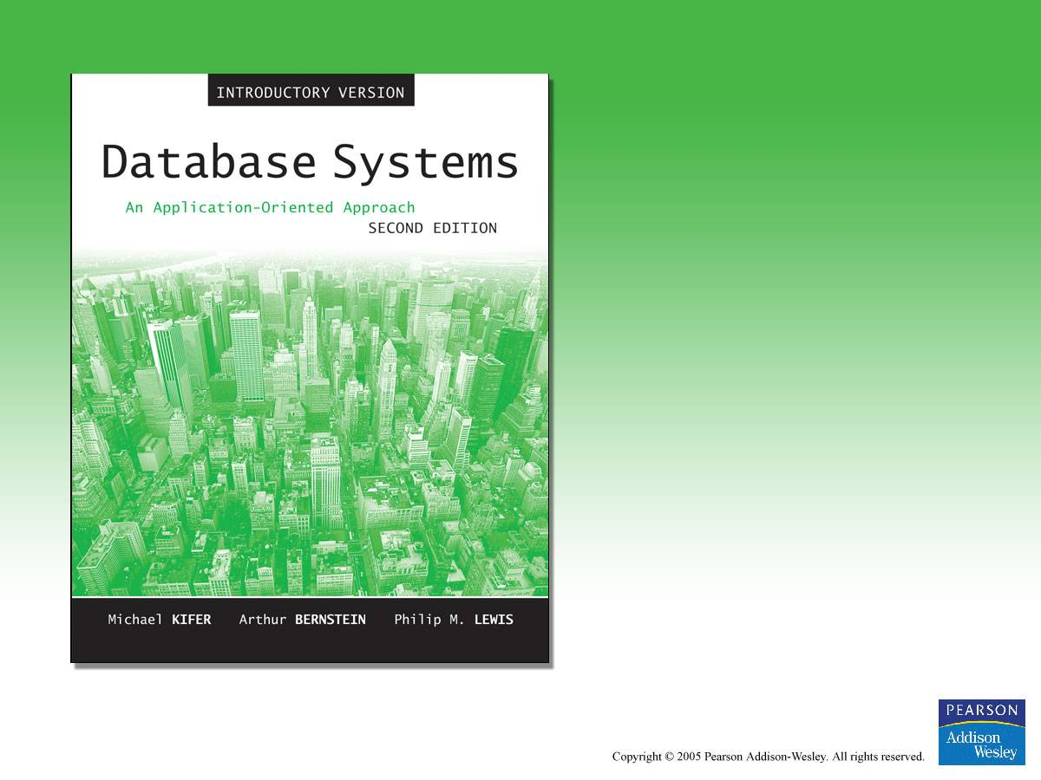
Textbook
Ji-Han Jiang
0-<number>

Slide 6
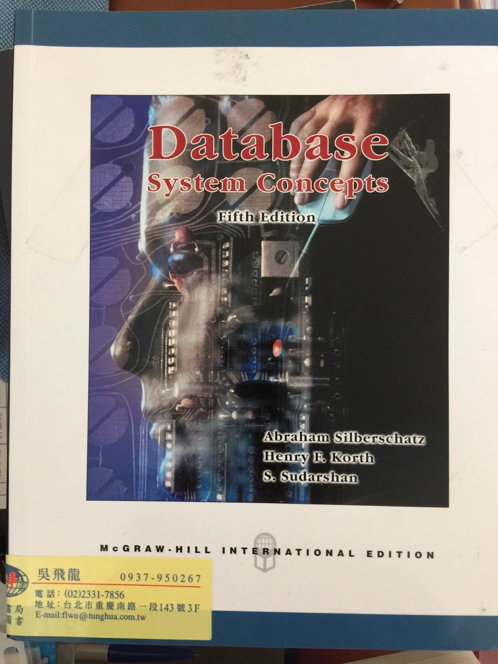
Textbook
Ji-Han Jiang
0-<number>

Slide 7

Textbook
Ji-Han Jiang
0-<number>

Slide 8
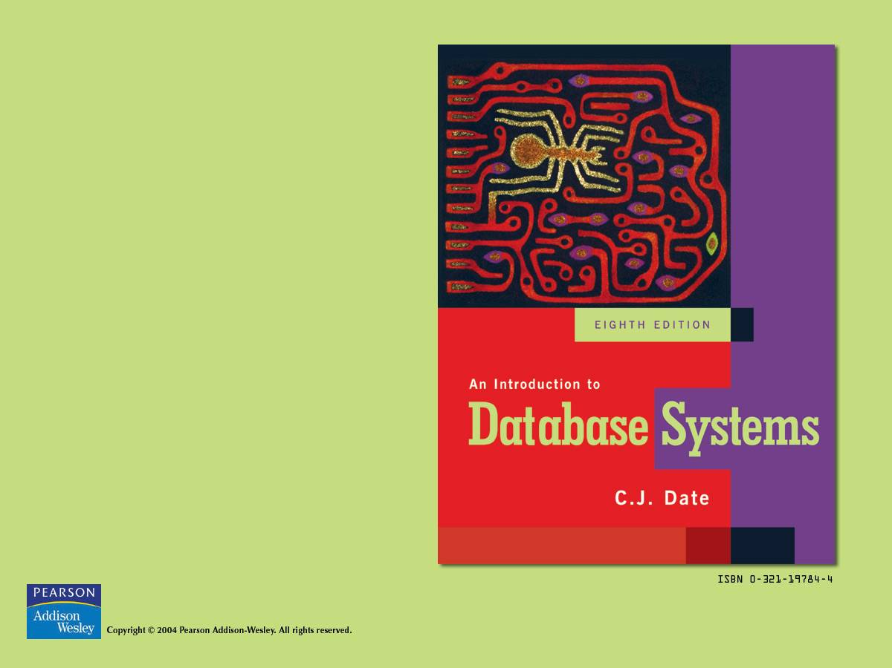
Reference
Book
Ji-Han Jiang
0-<number>

Slide 9
Syllabus－List
Part I Introduction
Part II Database Design
Part III Optimizing DBMS Performance and Transaction Processing
Part IV Software Engineering Issues and Documentation
Part V Advanced Topics in Databases
Supplements (補充教材)
Ji-Han Jiang
0-<number>

Slide 10
Syllabus－How to
Part III
Part I
Part II
Part V
Primary (基本的)
Advanced (進階)
Part IV
Individual Studying
(自習)
Supplements
Figure 1 Organization of teaching materials
Ji-Han Jiang
0-<number>

Slide 11
Syllabus-1
Part I Introduction
  Overview of Databases and Transactions
  Database Systems Architecture
    Three levels
      External level (Individual user views)
      Conceptual level (Community user views)
      Internal level (Storage views)
  The Big Picture
    Basic concepts
      The ACID properties of a Transaction
    Case study: A Student Registration System
Ji-Han Jiang
0-<number>

Slide 12
Syllabus-2
Part II Database Design
  Data Model
    The Relational Data Model
    Data Definition Language (DDL)
  Conceptual Modeling of Databases with
    Entity-Relationship Diagrams (ER-Diagram)&
    Unified Modeling Language (UML)
  Relational Algebra and SQL
  Database Design with the Relational Normalization Theory
  Triggers and Active Databases
Ji-Han Jiang
0-<number>

Slide 13
Syllabus-3 (Optional )
Part III Optimizing DBMS Performance and Transaction Processing
  Physical Data Organization and Indexing
  The Basics of Query Processing
  An Overview of Query Optimization
  Database Turing
  An Overview of Transaction Processing
Ji-Han Jiang
0-<number>

Slide 14
Syllabus-4 (Individual Studying )
Part IV Software Engineering Issues and Documentation
  Requirements and Specification
  Design, Coding, Testing, and Project Management
Ji-Han Jiang
0-<number>

Slide 15
Syllabus-5 (Optional )
Part V Advanced Topics in Databases
  Databases Security
  Introduction to Object Databases
  Introduction to XML and Web Data
Ji-Han Jiang
0-<number>

Slide 16
Syllabus-6 (Individual Studying )
Supplements
  Cases Studying
  Structured Query Language (SQL)
  Database Management Systems
    SQL Server (Ms. Window)
    MySQL (Linux)
  Database Tips
Ji-Han Jiang
0-<number>

